Slide 1

Fantastic Four
Cast: [Group 2]
Akhila Vemana :801149644
Anushka Tibrewal :801134231
Sushma Saparapu :801135662
Siddesh Suhas Sarfare :801134143

Slide 2
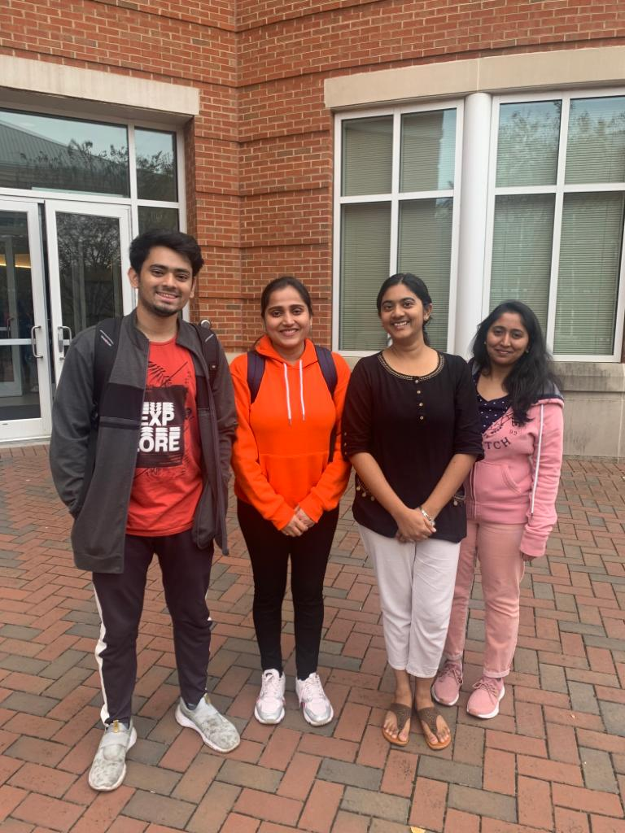

Slide 3
Agenda for Deliverable 4
Scope of the project
Business rules in List format
Enhanced Entity Relationship Diagram
Data dictionary
Advanced SQL statements

Slide 4
Scope:
The scope of our project, Food Delivery System is to provide food delivery services for the students of UNC Charlotte within the campus.
The database system is fully normalized using business rules, entity relationship diagramming, normalization and schema design.
Since we have the database which has lots of data, we split the data into multiple tables that stores this data and joined the tables wherever required in order to get the desired outcome.
We have made the system secure by providing authorization to the admins managing it.

Slide 5
Business Rules
Person entity to Order entity : one-to-many relationship
Location entity to Order entity : one-to-many relationship
Order entity to order-items entity : one-to-many relationship
Order-items entity and ItemRestaurantMapping: many-to-many relationship
Order entity and Driver entity : many-to-one relationship
Restaurant entity and ItemRestaurantMapping entity:many-to-many relationship
Driver entity and Vehicle entity : one-to-many relationship
ItemRestaurantMapping entity and ItemMaster entity: many-to-many relationship

Slide 6
EERD

Slide 7
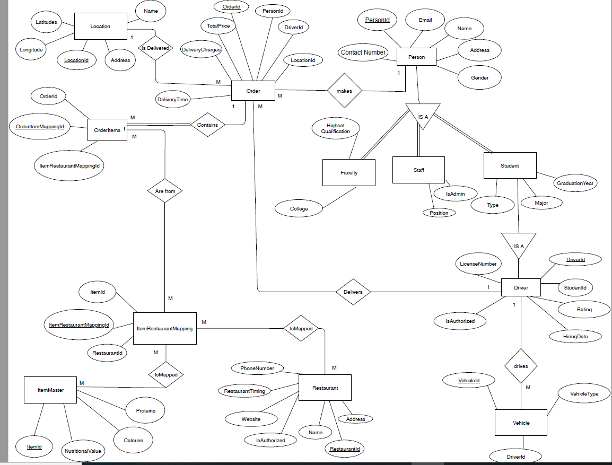

Slide 8
Data Dictionary

Slide 10
Advanced SQL Statements

Slide 12
THANK YOU

